Slide 1

Technical SEO
By Vahid Afshari

Slide 2
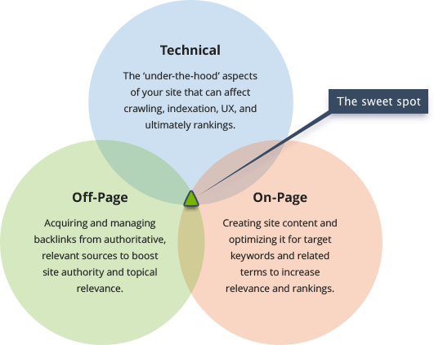
Introduction
Everybody Talks about Off-Page SEO a lot. backlink and Content are Important but Technical is a hot topic too.
There is no doubt that Coding and Server Trick are very important to getting rank on Google. The Technical side of SEO is just as important as Off-Page. If you don’t care about that, Your hard working on off-page going to lose.

Slide 3
Before a website can be accessed, it needs to be set up!
Domain name is purchased
Domain name is linked to IP address
User requests domain
Browser makes requests
Server sends resources
Browser assembles the web page - (DOM)?
Browser makes final requests
Website appears in browser

Slide 4
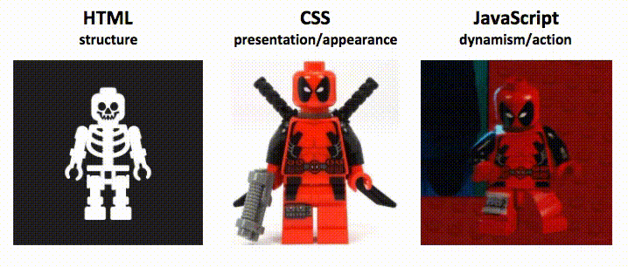
what a website is made
HTML – What a website says (titles, body content, etc.)
CSS – How a website looks (color, fonts, etc.)
JavaScript – How it behaves (interactive, dynamic, etc.)

Slide 5

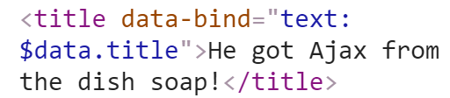
What is the Document Object Model (DOM)?
The DOM is what you see when you “Inspect Element” in a browser. Simply put, you can think of the DOM as the steps the browser takes after receiving the HTML document to render the page.
HTML source | DOM

Slide 6
What is headless browsing?
Headless browsing is simply the action of fetching webpages without the user interface. It is important to understand because Google, and now Baidu, leverage headless browsing to gain a better understanding of the user’s experience and the content of webpages.
PhantomJS and Zombie.js are scripted headless browsers, typically used for automating web interaction for testing purposes, and rendering static HTML snapshots for initial requests (pre-rendering).

Slide 7
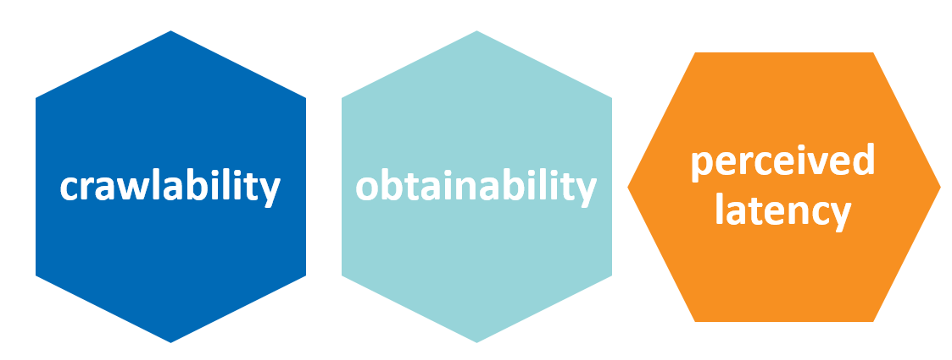
Why can JavaScript be challenging for SEO?
Crawlability: Bots’ ability to crawl your site.
Obtainability: Bots’ ability to access information and parse your content.
Perceived site latency: AKA the Critical Rendering Path.

Slide 8
Crawlability
Blocking search engines from your JavaScript
This means search engines are not seeing what the end user is seeing. This can reduce your site’s appeal to search engines and could eventually be considered cloaking
The easiest way to solve this problem is through providing search engines access to the resources they need to understand your user experience.
Internal linking should be implemented with regular anchor tags within the HTML or the DOM (using an a hrefs="www.example.com" HTML tag) versus leveraging JavaScript functions to allow the user to traverse the site.
Don’t use JavaScript’s onclick events as a replacement for internal linking.
Internal linking is a strong signal to search engines regarding the site’s architecture and importance of pages.

Slide 9
URL structure
Historically, JavaScript-based websites (aka “AJAX sites”) were using fragment identifiers (#) within URLs.
Not recommended:
The Lone Hash (#)
Hashbang (#!) (and escaped_fragments URLs)
Recommended:
pushState History API

Slide 10
Obtainability
Search engines have been shown to employ headless browsing to render the DOM to gain a better understanding of the user’s experience and the content on page. That is to say, Google can process some JavaScript and uses the DOM
Google is a lazy user. It doesn’t click, it doesn’t scroll, and it doesn’t log in. If the full UX demands action from the user, special precautions should be taken to ensure that bots are receiving an equivalent experience.
If the JavaScript occurs after the JavaScript load event fires plus ~5-seconds*, search engines may not be seeing it.
If there are errors within the JavaScript, both browsers and search engines won’t be able to go through and potentially miss sections of pages if the entire code is not executed.

Slide 11
How to make sure Google and other search engines can get your content
1- Test
If you can see your content in the DOM, chances are your content is being parsed by Google.
Confirm that your content is appearing within the DOM.
Test a subset of pages to see if Google can index content.
Manually check quotes from your content.
Fetch with Google and see if content appears.
Fetch with Google supposedly occurs around the load event or before timeout.

Slide 12
How to make sure Google and other search engines can get your content
2- HTML SNAPSHOTS
HTML snapshots are a fully rendered page (as one might see in the DOM) that can be returned to search engine bots (think: a static HTML version of the DOM).
If search engines (or sites like Facebook) cannot grasp your JavaScript, it’s better to return an HTML snapshot than not to have your content indexed and understood at all. Ideally, your site would leverage some form of user-agent detection on the server side and return the HTML snapshot to the bot.
“The HTML snapshot must contain the same content as the end user would see in a browser. If this is not the case, it may be considered cloaking.”

Slide 13
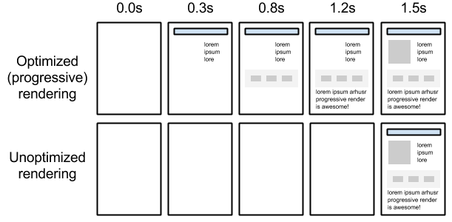
Site latency
When browsers receive an HTML document and create the DOM (although there is some level of pre-scanning), most resources are loaded as they appear within the HTML document. This means that if you have a huge file toward the top of your HTML document, a browser will load that large file first.
The concept of Google’s critical rendering path is to load what the user needs as soon as possible, which can be translated to → "get everything above-the-fold in front of the user, ASAP."

Slide 14
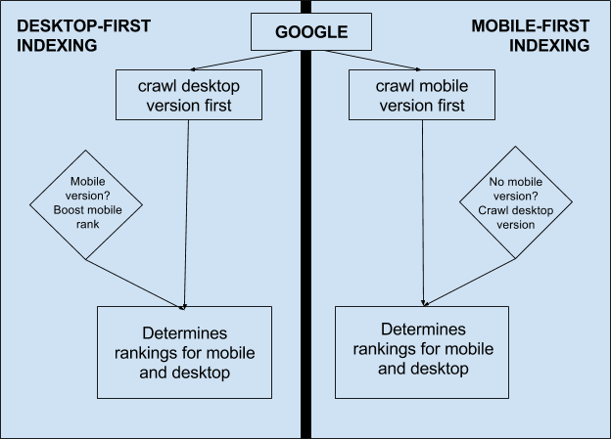
Mobile First Index
Mobile-first indexing is exactly what it sounds like. It just means that the mobile version of your website becomes the starting point for what Google includes in their index, and the baseline for how they determine rankings. If you monitor crawlbot traffic to your site, you may see an increase in traffic from Smartphone Googlebot, and the cached versions of pages will usually be the mobile version of the page.

Slide 15
What should I do about mobile-first indexing?
If you have a responsive site or a dynamic serving site where the primary content and markup is equivalent across mobile and desktop, you shouldn’t have to change anything.
If you have a site configuration where the primary content and markup is different across mobile and desktop, you should consider making some changes to your site.
Make sure to serve structured markup for both the desktop and mobile version.
If you are a site owner who has only verified their desktop site in Search Console
If you only have a desktop site, we'll continue to index your desktop site just fine, even if we're using a mobile user agent to view your site.

Slide 16
Delivering mobile-optimized experiences
Responsive design. With this approach, nothing really changes. Your website’s uniform resource locators (URLs) remain the same, and the HyperText Markup Language (HTML) code served is identical as well. The site’s design will adapt to the size of the screen it’s being shown on, delivering a mobile experience catered to the device’s specific screen resolution. Google recommends responsive design as its preferred design pattern, as it requires the least effort from their end; there is no extra code to index and no additional URLs to crawl.
Dynamic serving. Sometimes websites will detect the user-agent when a page is being loaded and serve different HTML code on the same URL depending on the type of device that’s being used. This is called dynamic serving. It is the same URL, different HTML code, one for desktop users and another for mobile users.
Separate mobile URL. In this approach, a website will serve different code to mobile users as well and will also use different URLs for its mobile site. Often a website will serve its mobile content from a separate subdomain, like m.website.com, or from a different subfolder like www.website.com/mobile/.

Slide 17
Mobile SERP Technical SEO checklist
On-page SEO
Structured data
Hreflang tags
Pagination
Internal link structure
Reasonable surfer approach
Site configuration
Robots.txt
Redirects
Crawl rate
Double-check everything, then check again

Slide 18
What is an Internal Link?
Internal links are links that go from one page on a domain to a different page on the same domain. They are commonly used in main navigation.
These type of links are useful for three reasons:
They allow users to navigate a website.
They help establish information hierarchy for the given website.
They help spread link equity (ranking power) around websites.

Slide 19
Internal Links Best Practice
Google's colorful spider has reached page "A" and sees internal links to pages "B" and "E." However important pages C and D might be to the site, the spider has no way to reach them—or even know they exist—because no direct, crawlable links point to those pages. As far as Google is concerned, these pages basically don’t exist–great content, good keyword targeting, and smart marketing don't make any difference at all if the spiders can't reach those pages in the first place.
1. Anchor text is something that can be considered. The search engines have generally minimized its importance, but it's certainly something that's in there for internal links.
2. The location on the page actually matters quite a bit, just as it does with external links. Internal links, it's almost more so in that navigation and footers specifically have attributes around internal links that can be problematic.
3. The link target matters obviously from one place to another.

Slide 20
4. The importance of the linking page, this is actually a big one with internal links. So it is generally the case that if a page on your website has lots of external links pointing to it, it gains authority and it has more ability to sort of generate a little bit, not nearly as much as external links, but a little bit of ranking power and influence by linking to other pages. So if you have very well-linked two pages on your site, you should make sure to link out from those to pages on your site that a) need it and b) are actually useful for your users. That's another signal we'll talk about.
5. The relevance of the link, so pointing to my shipping routes page from a page about other types of shipping information, totally great. Pointing to it from my dog food page, well, it doesn't make great sense. Unless I'm talking about shipping routes of dog food specifically, it seems like it's lacking some of that context, and search engines can pick up on that as well.
6. The first link on the page. So this matters mostly in terms of the anchor text, just as it does for external links. Basically, if you are linking in a bunch of different places to this page from this one, Google will usually, at least in all of our experiments so far, count the first anchor text only. So if I have six different links to this and the first link says "Click here," "Click here" is the anchor text that Google is going to apply, not "Click here" and "shipping routes" and "shipping." Those subsequent links won't matter as much.
7. Then the type of link matters too. Obviously, I would recommend that you keep it in the HTML link format rather than trying to do something fancy with JavaScript. Even though Google can technically follow those, it looks to us like they're not treated with quite the same authority and ranking influence. Text is slightly, slightly better than images in our testing, although that testing is a few years old at this point. So maybe image links are treated exactly the same. Either way, do make sure you have that. If you're doing image links, by the way, remember that the alt attribute of that image is what becomes the anchor text of that link.

