Slide 1
SEO
The closest look ever

Slide 2
Looking at SEO: From far away
What we see is:
What SEO is.
How it’s done.
Goals
Uses
Main challenges
Etc.

Slide 3
Looking at SEO: A closer look
What we see is:
What are the factors that impact SEO (200, 250, 500, W/E )

Slide 4
Looking at SEO: An even closer look
What we see is:
How to get the most out of those SEO factors.
How links are meant to be.
Title tag, Meta description, etc.

Slide 5
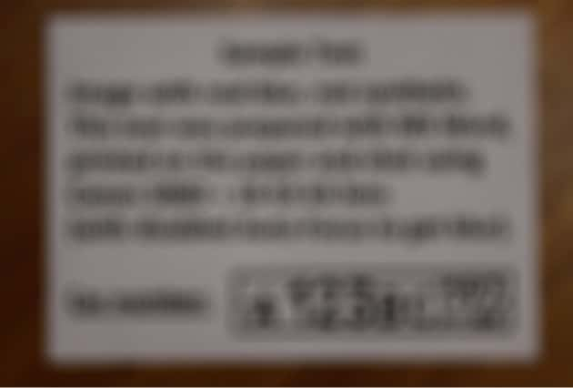
Looking at SEO: The closest look ever
What we see is:
What we need is a GENUINE source of knowledge which is not MANIPULATED.
Webmaster central ( By Google ).
Search quality evaluator guidelines ( By Google) and the changes that are pure.

Slide 6
SEO fundamentals
AUTHORITY
TRUST
RELEVANCY

Slide 7
Authority
Authority in real world
Authority in SEO
Similar metrics out there
Uses
Link earning and building
Authority and trusted resources
Relevant resources
Link anchor text ( To super authority websites like Moz)
Raters guidelines.
Etc.

Slide 8
Trust
Trust in real world
Trust in SEO
Signs of existence
Websites that publish content take the most impressions within a few mins.
Uses
Link earning and building
Authority and relevant resources
Trusted resources
Outbound links and citations
Link anchor text ( To super authority websites like twitter)
Etc.

Slide 9
Relevancy
Relevancy in real world
Relevancy in SEO
Uses
On-page SEO
All the factors
Semantic HTML
Technical SEO
Etc.

Slide 10
Does any authority agree?
VIDEO

Slide 11
What relevancy is ( an intro to Semantic HTML )
www
A specific domain
A specific sub-domain
A specific directory
A specific page
A specific section
MORE
Relevant

